Slide 1
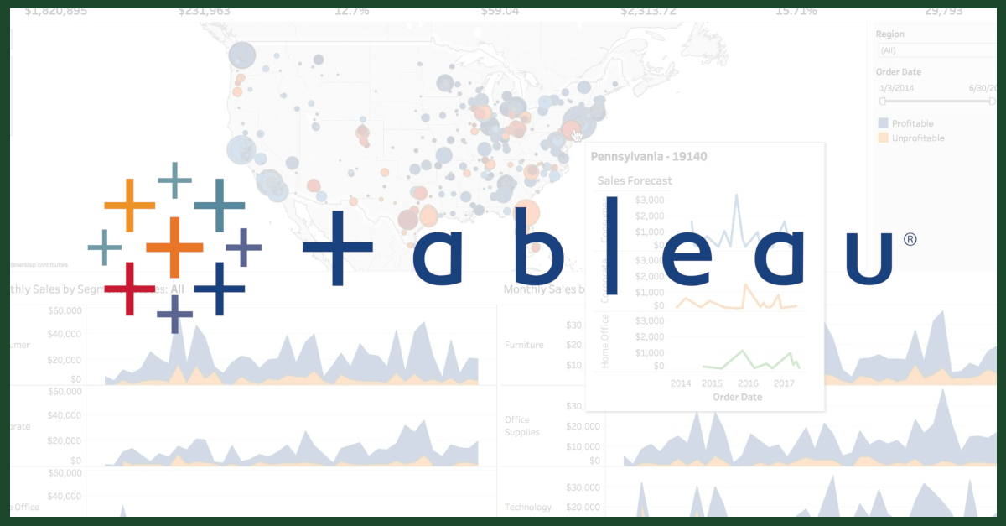
Tableau

Slide 2
Data Visualization
Importance of Visualization
History of Visualization
Visualization Tools
What is Tableau ?
Why Tableau ?
Tableau Range of Products
Tableau Vs Power BI
Tableau Interface
Tableau File Types & Extensions
Connects
Data Types
Dimension & Measure
Tools Used
Pivot Table
Export Work from Tableau
Chart in Tableau
Line Chart
Bar Chart
Histogram
Scatter Plot
Bubble Chart
Pie Chart
Dual Axis Chart
Geospatial Analysis
Calculated Fields
Parameters
Joins in Tableau
Data Blending

Slide 3

Data Visualization
Data visualization is the process of representing data in a visual format, such as charts, graphs, maps, or dashboards, to make complex information easier to understand and analyze.
Data visualization is widely used in various fields, including business, healthcare, finance, science, and technology, to help drive insights and actions.

Slide 4
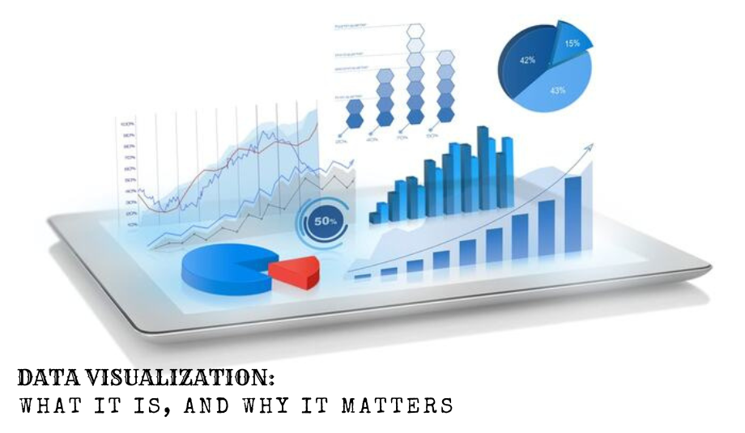
Importance of Visualization
Humans process visual information 60,000 times faster than text.
Makes complex data more accessible and understandable.
Speeds up analysis process.
Visual data is often more engaging and memorable.
Supports Storytelling and Communication.

Slide 5

History of visualization
The history of data visualization dates back centuries. Early forms of data visualization can be traced back to cave paintings, ancient maps, etc…
Ancient civilizations like the Egyptians used symbols and drawings to record information, primarily for astronomical and agricultural purposes.
Note: Cave paintings (30,000 BCE) - First known visual representations.

Slide 6
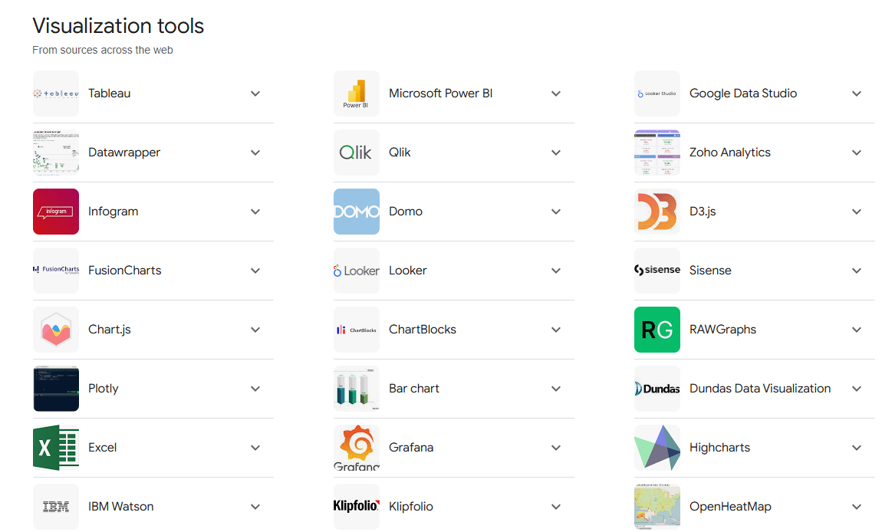
Visualization tools

Slide 7

What is Tableau ?
Tableau is a popular data visualization and business intelligence software that helps people see and understand their data through interactive visualizations and dashboards.
Tableau is widely used in business intelligence, finance, healthcare, and other industries, helping professionals make data-driven decisions and communicate insights effectively.

Slide 8

Why TABLEAU ?
Ease of Use
Connects to almost any data source
66 Data Sources
Real-Time Analytics
Advanced Visual Capabilities
Handles large amounts of data efficiently
Collaborative Sharing
Tableau has a strong community
Less time required to pull and prepare data

Slide 9
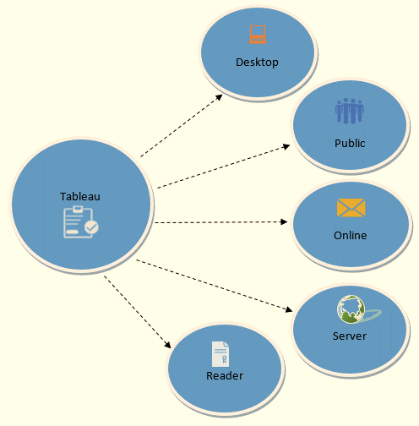
Tableau RANGE OF PRODUCTS

Slide 10
POWER BI Vs TABLEAU
POWER BI
TABLEAU
Affordable with free desktop version
Good for small to medium datasets
Limited customization, pre-built visuals
Growing community
Best for Beginners
Higher cost, especially for larger teams
Better performance with large datasets
Highly customizable, rich visuals
Established community
Best for Advanced users

Slide 11
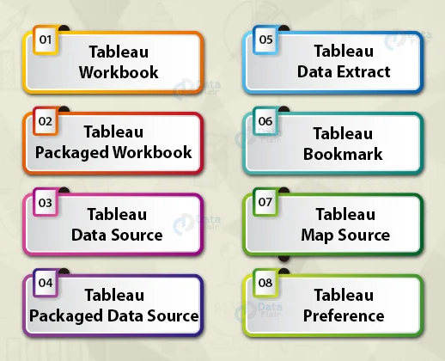
Tableau File Types & Extensions
Tableau Workbook (.twb)
Tableau Packaged Workbook (.twbx)
Tableau Data Source (.tds)
Tableau Packaged Data Source (.tdsx)
Tableau Data Extract (.tde)
Tableau Bookmark (.tbm)
Tableau Map Source (.tms)
Tableau Preference (.tps)

Slide 12
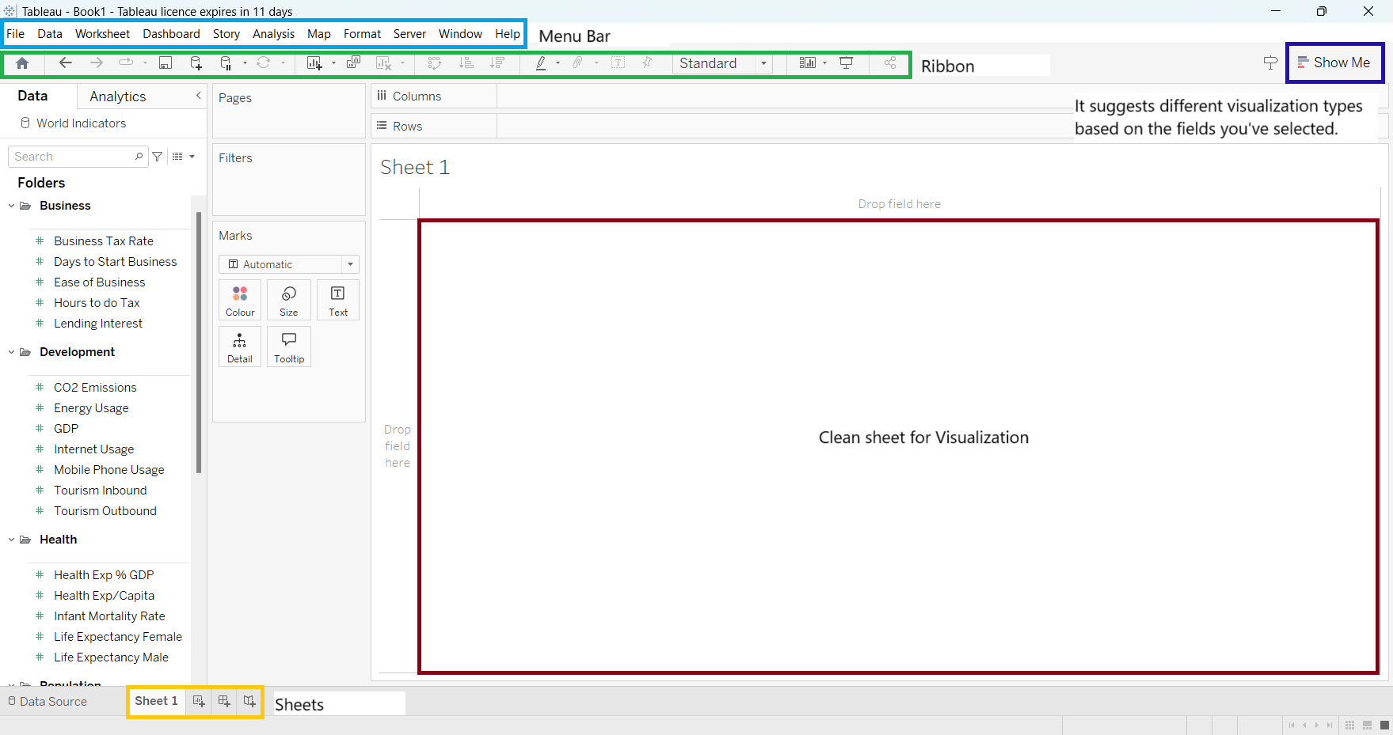
Tableau Interface

Slide 13
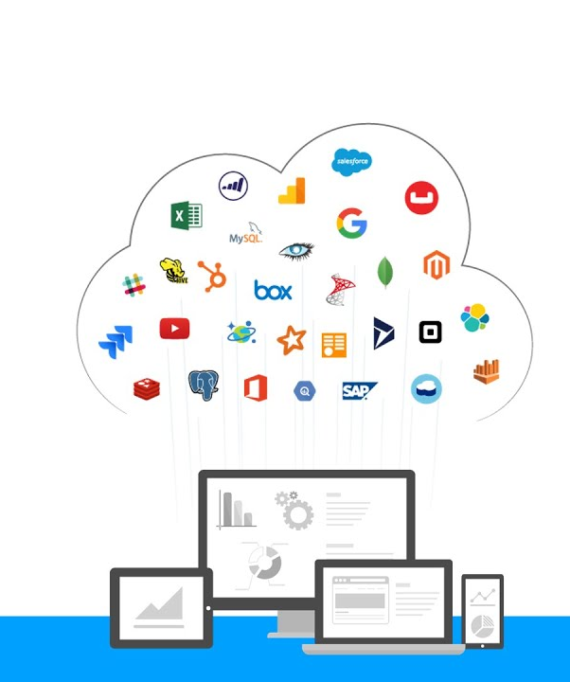
Connect
In the context of Tableau, "Connects" typically refers to establishing a connection to data sources. This connection allows users to pull data into the software for analysis, reporting, and visualization.
CONNECT
Local Server
(Excel, CSV,Text, (MySQL,Oracle,
PDF, etc..) Salesforce, etc..)

Slide 14
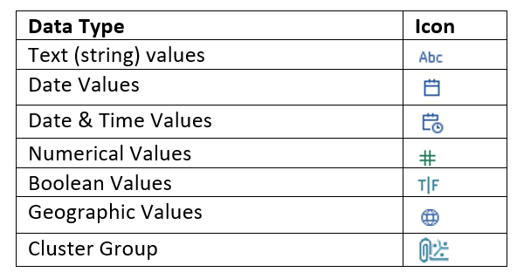
Data TYPES

Slide 15
Dimension & Measure
Dimension
Dimensions are qualitative data fields that typically represent categorical data.
Customer Name
Product Category
Region
Order Date
Measure
Measures are quantitative data fields that contain numerical values.
Sales
Profit
Quantity
Discount

Slide 16
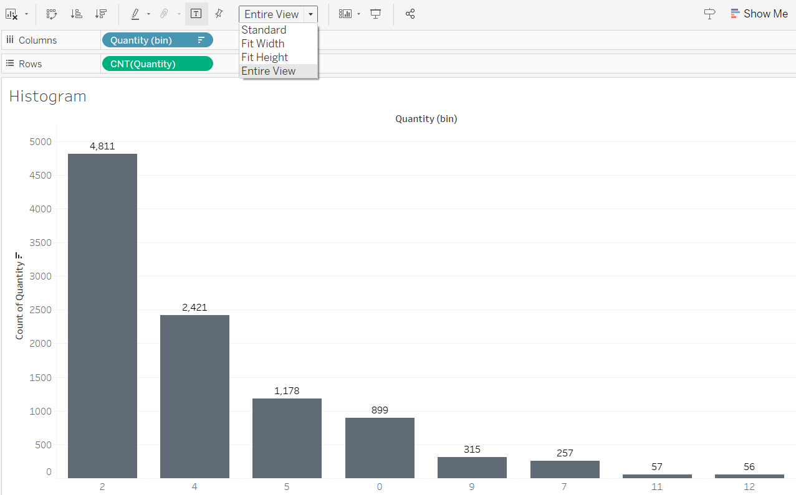
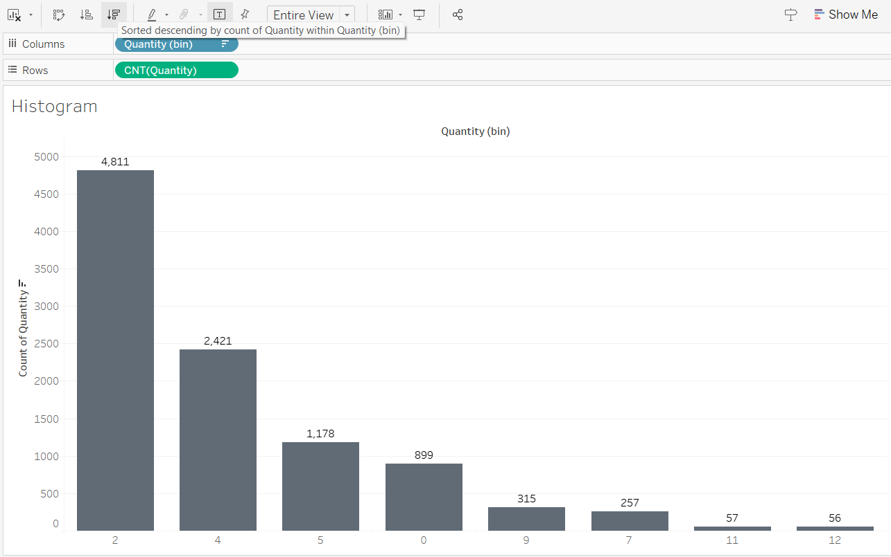
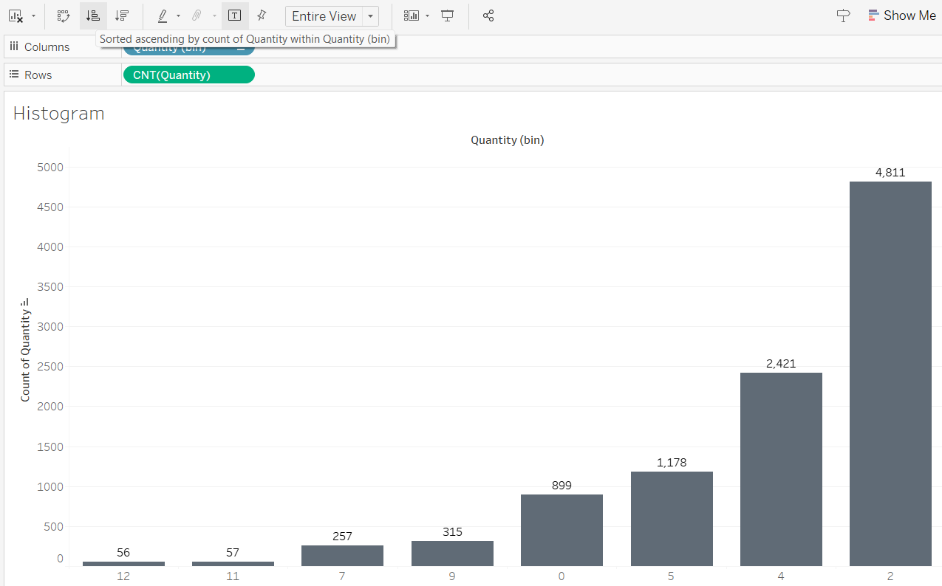
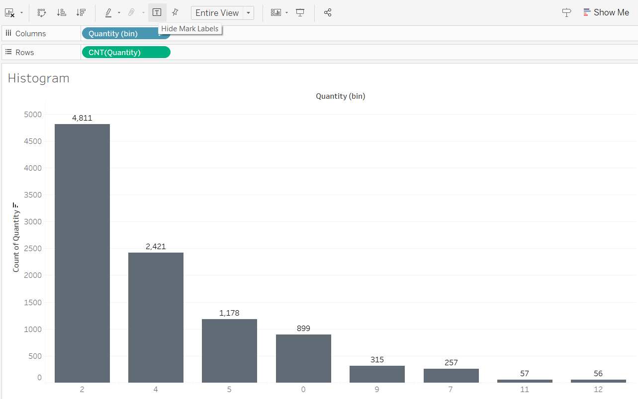
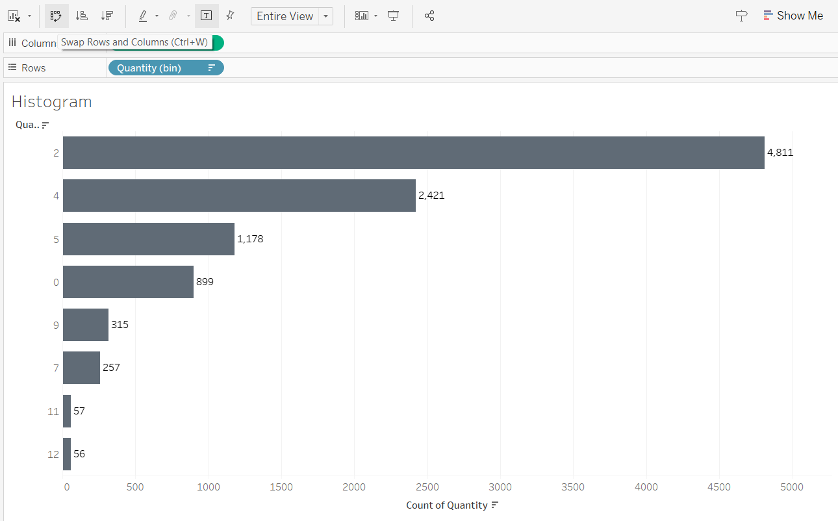
Tools Used
Entire View
Sort Descending
Sort Ascending
Mark Labels/Hide Labels
Swap Rows & Columns

Slide 17
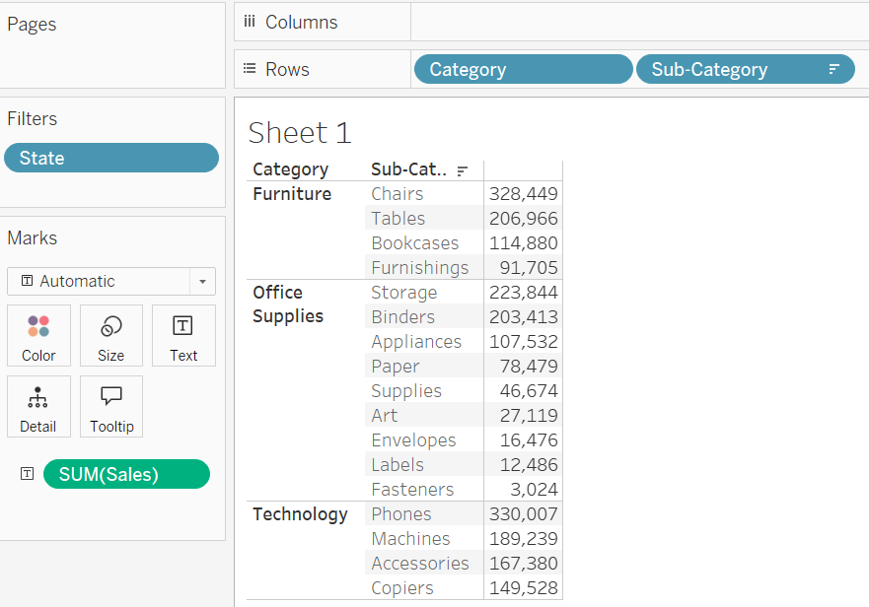
Pivot table
Creating a pivot table in Tableau is a great way to summarize and analyze data in a matrix format.
Pivot tables in Tableau are used to summarize data by dragging and dropping fields into rows, columns, and values to see how different categories relate to each other.

Slide 18
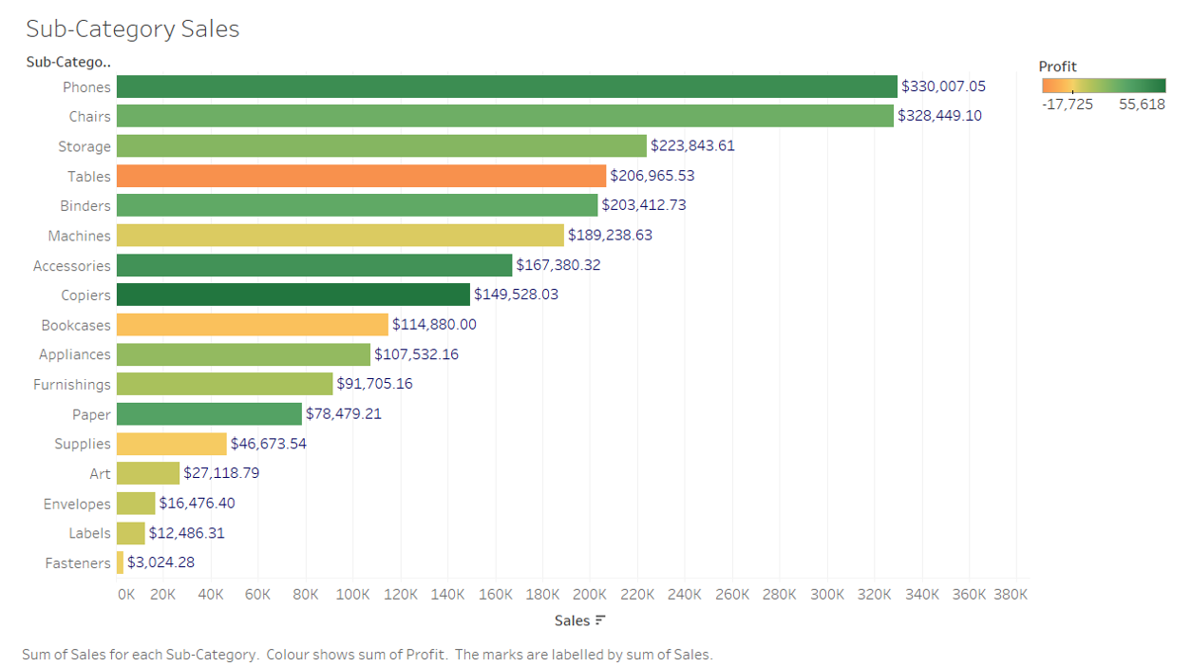
Export work from tableau
Exporting your work from Tableau is a straightforward process. You can export your Tableau workbook or its components in various formats depending on what you need.
1. Export as Image
Right Click
Copy (Select Image)
Paste
2. Export as PPT
File
Export as ppt

Slide 19
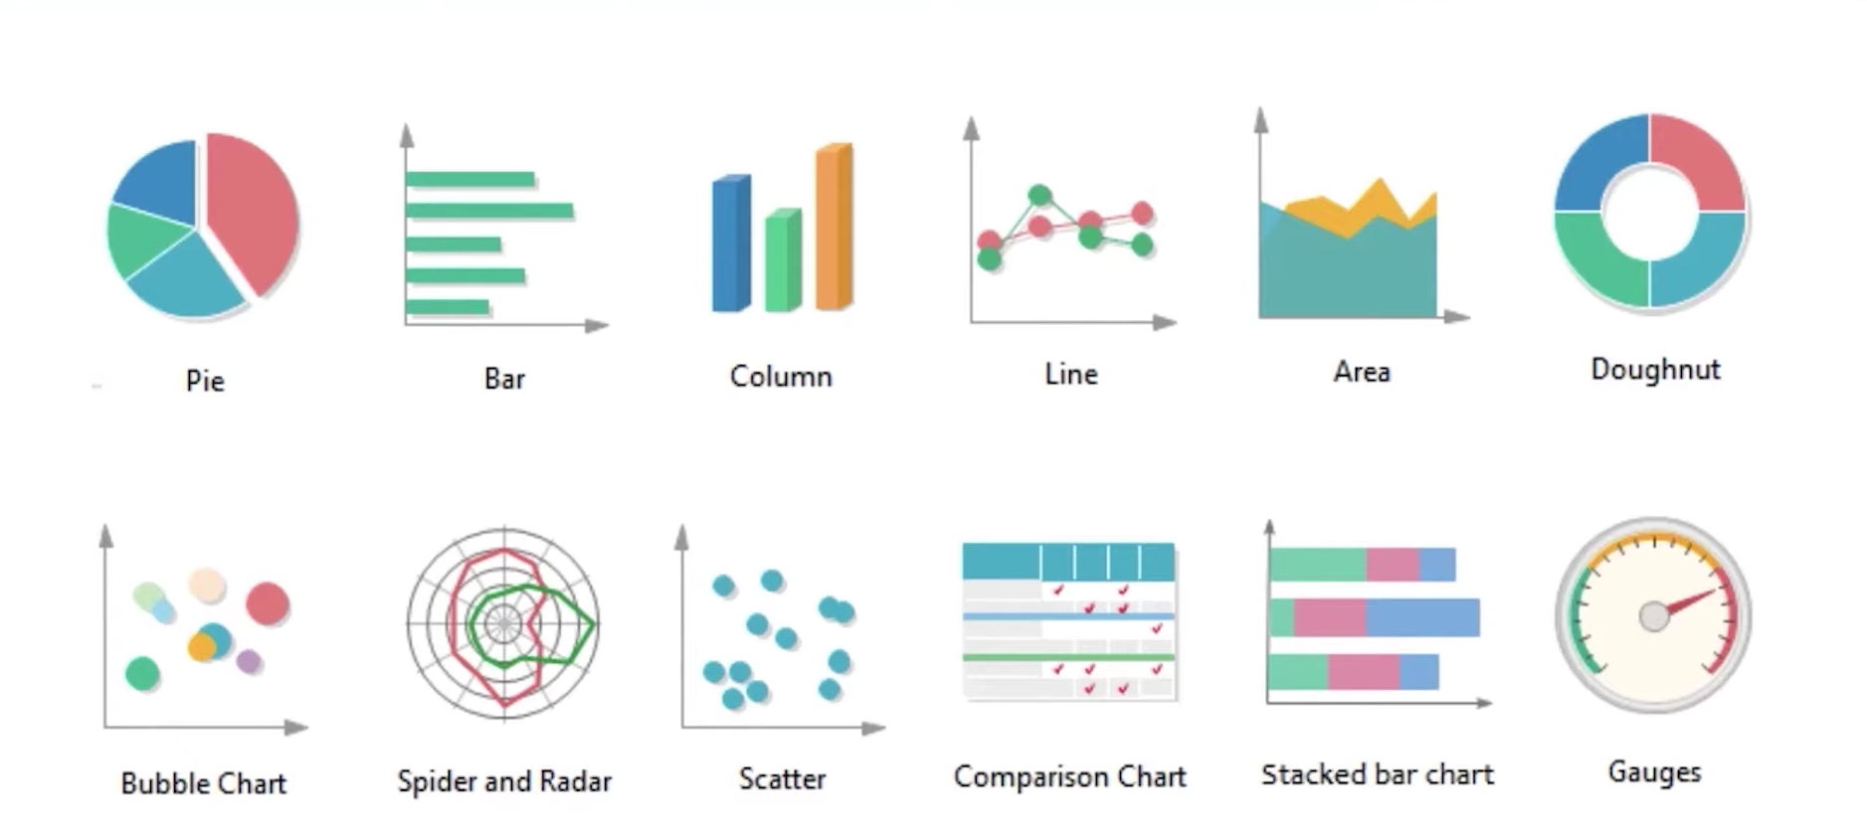
Charts in tableau
jk

Slide 20
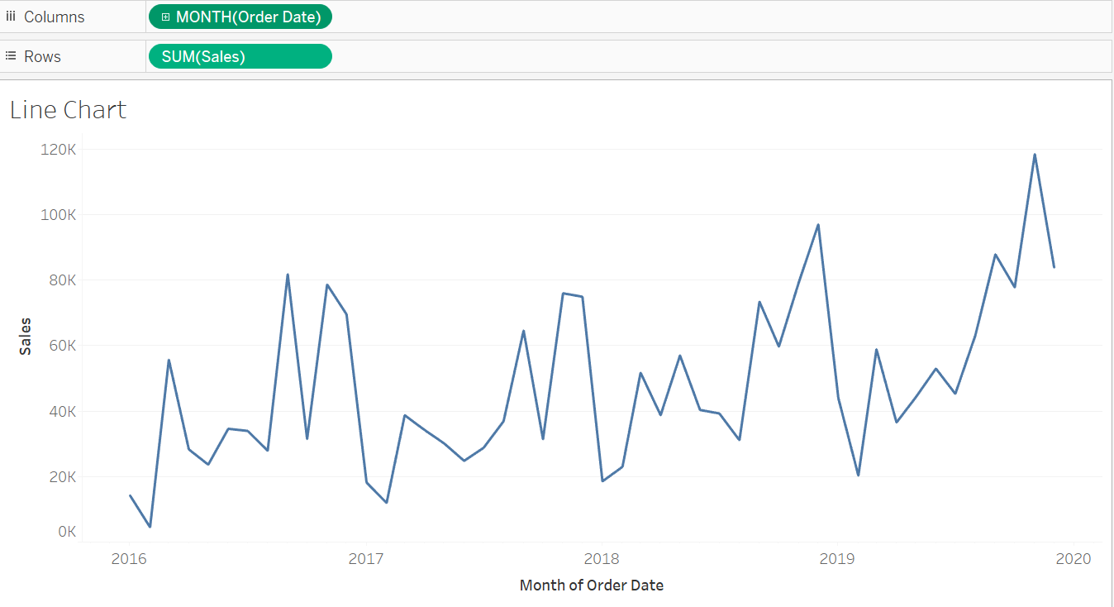
Line chart

Slide 21
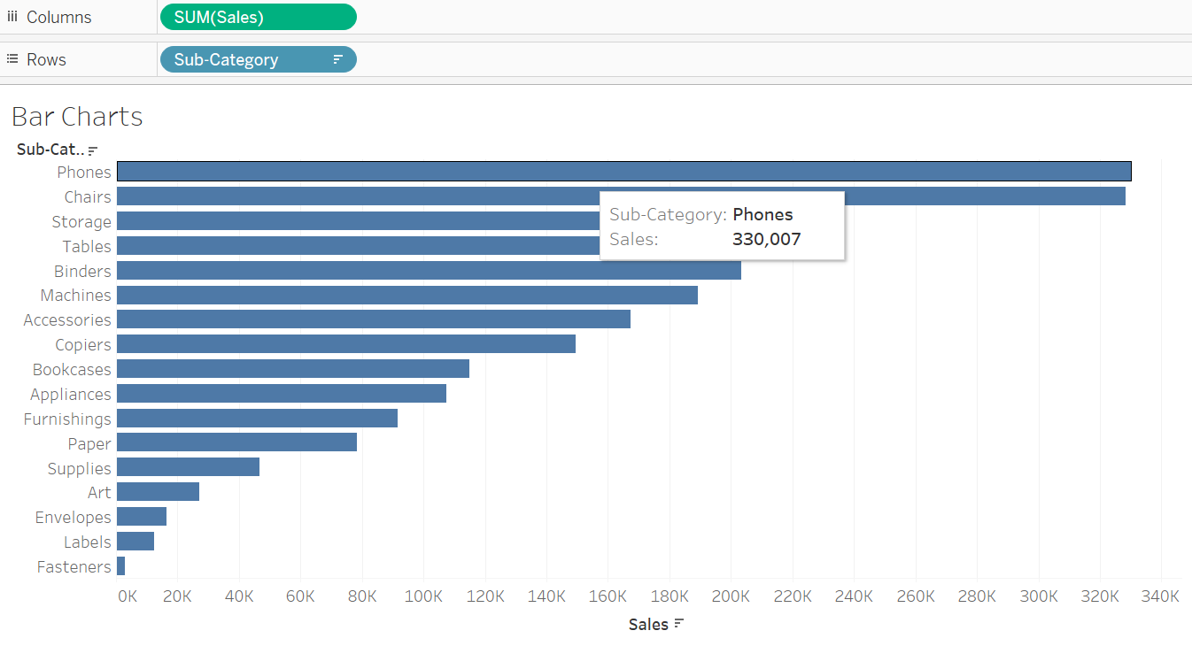
Bar chart

Slide 22
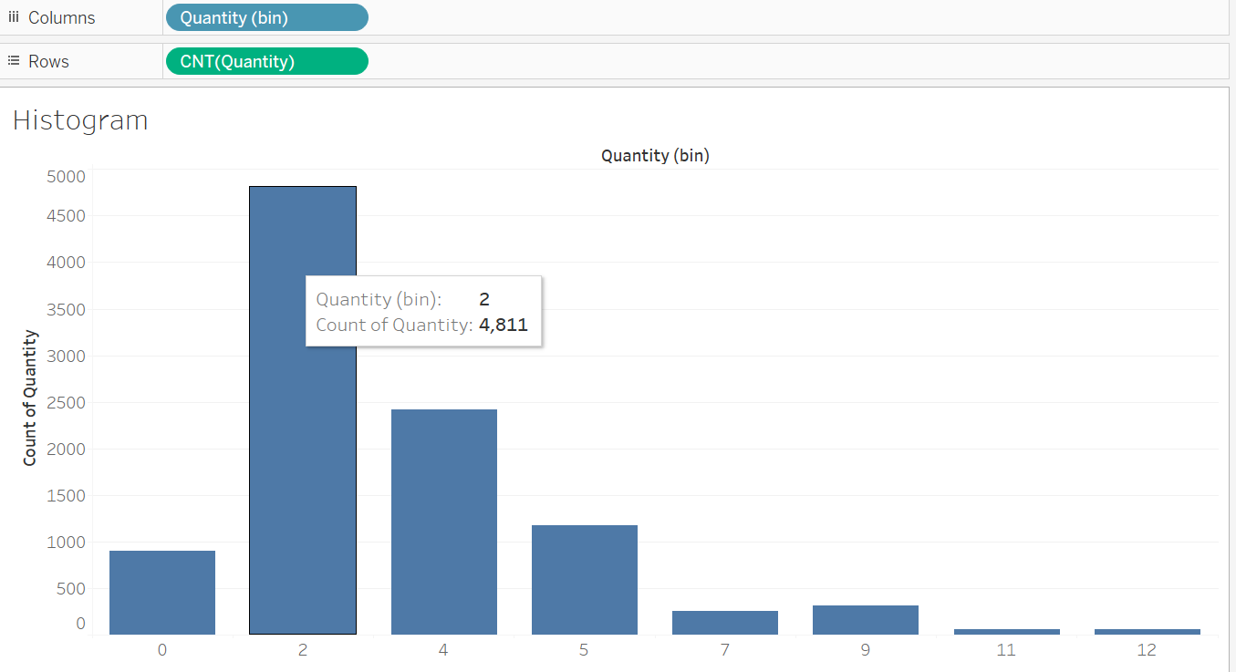
Histogram

Slide 23
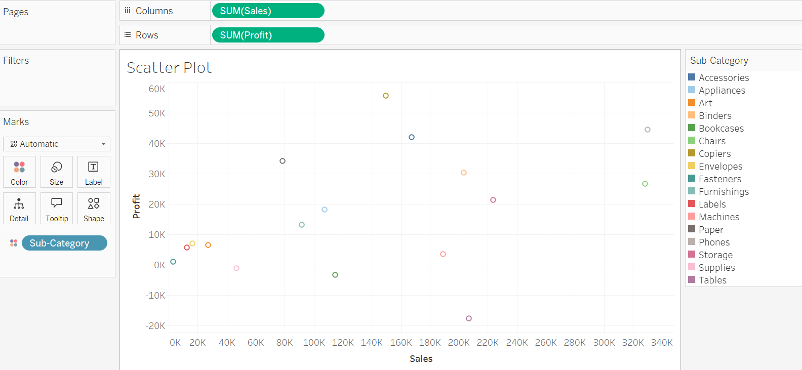
Scatter plot

Slide 24
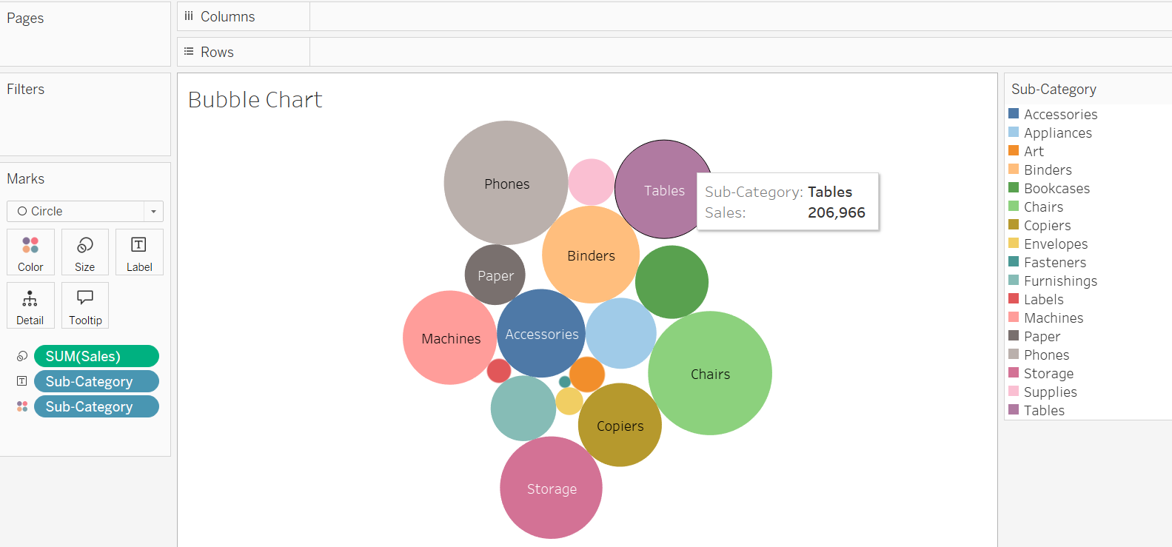
Bubble chart

Slide 25
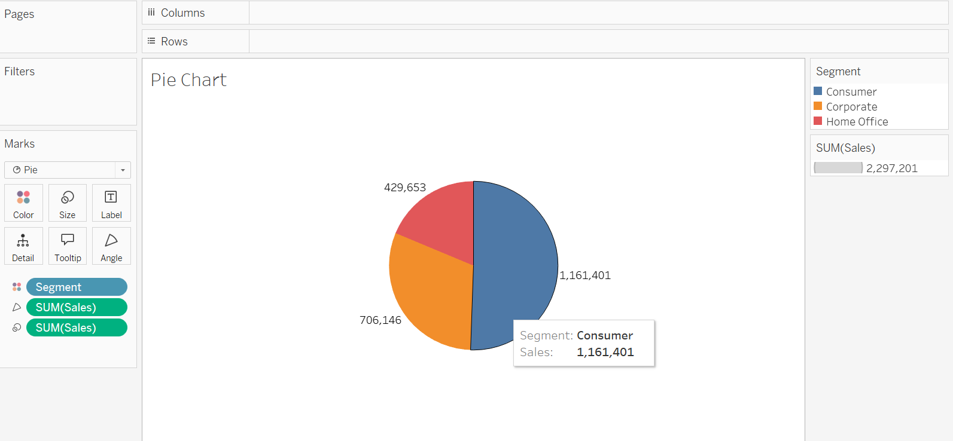
Pie chart

Slide 26
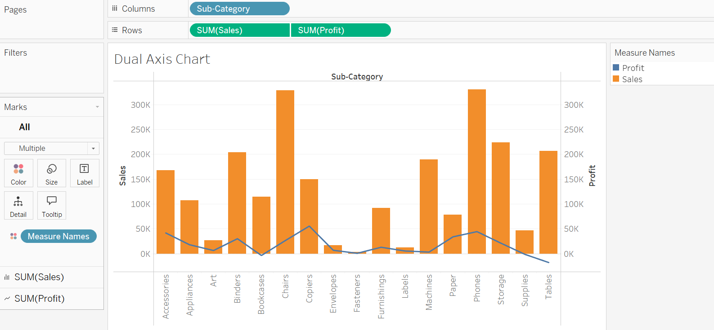
Dual axis chart

Slide 27
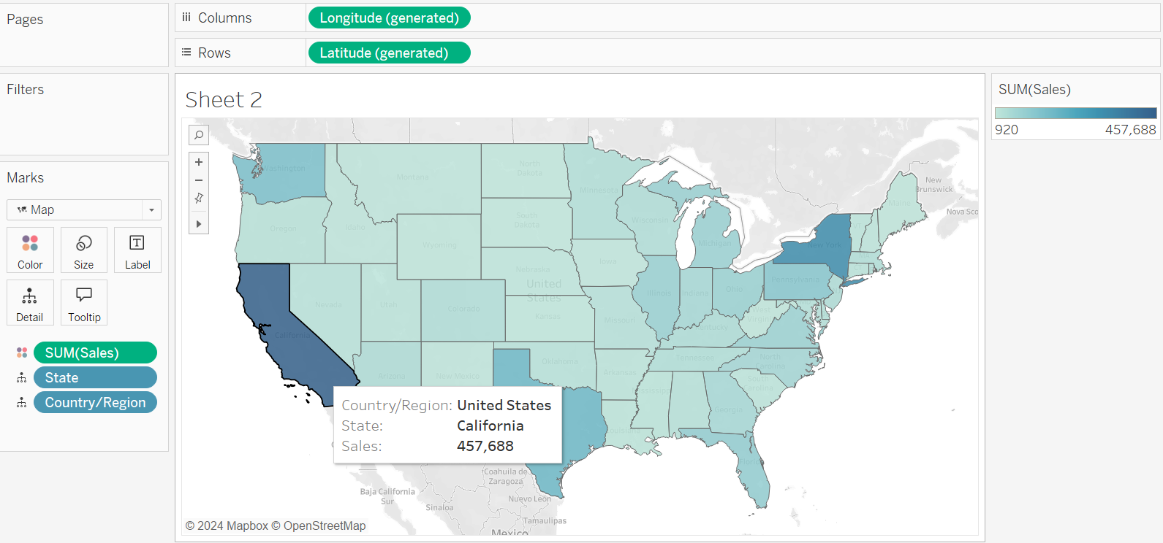
Geospatial analysis
Geospatial analysis in Tableau allows you to visualize and analyze geographic data, such as locations, regions, and spatial relationships, using maps. Tableau has powerful geospatial features that can help you plot points on a map, create choropleth maps (colored regions), analyze distances, and perform spatial calculations.

Slide 28
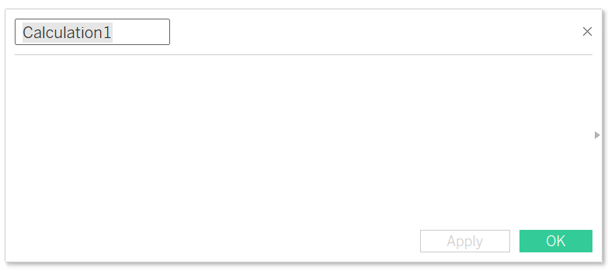
Calculated fields
Calculated fields allows us to create new columns(or data) from our already existing data.
Method 1:
Right click on Measure
Create calculated field
Method 2:
Click on Analysis
Create calculated field
Method 3:
Click on dropdown arrow next to dimension
Create calculated field

Slide 29
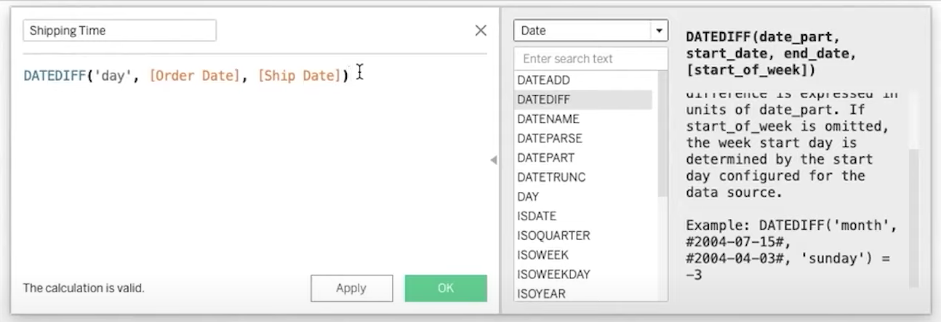
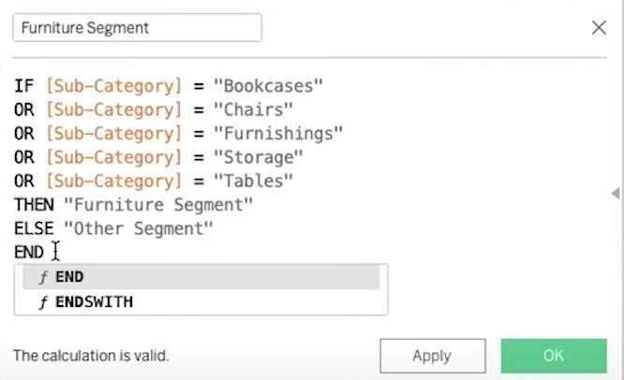
Basic calculated field
Calculated field using if else

Slide 30
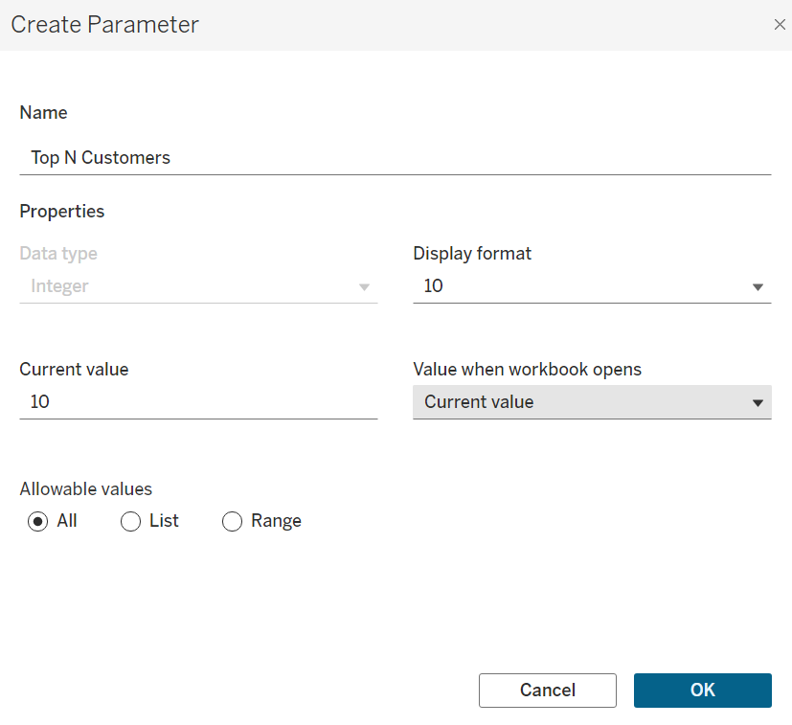
Parameters
Parameters are dynamic values that can replace constant values in calculations, filters, and reference lines.
Method 1:
Drag in filter
Create Parameter
Method 2:
Click on the dropdown arrow next to dimension
Create Parameter

Slide 31
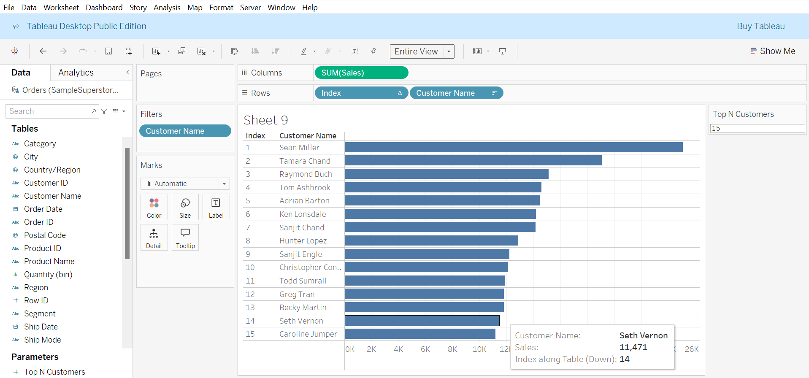

Slide 32
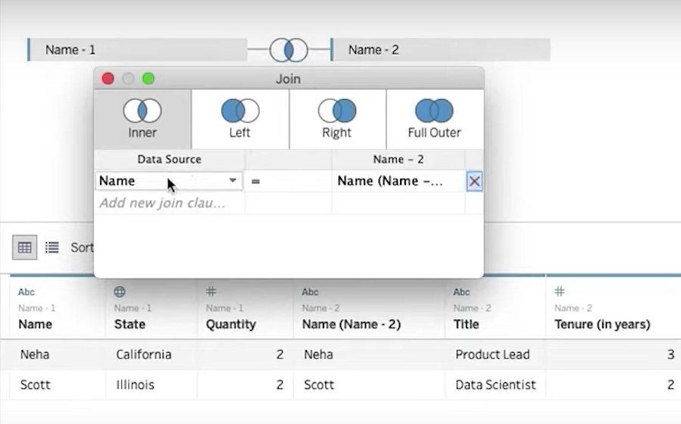
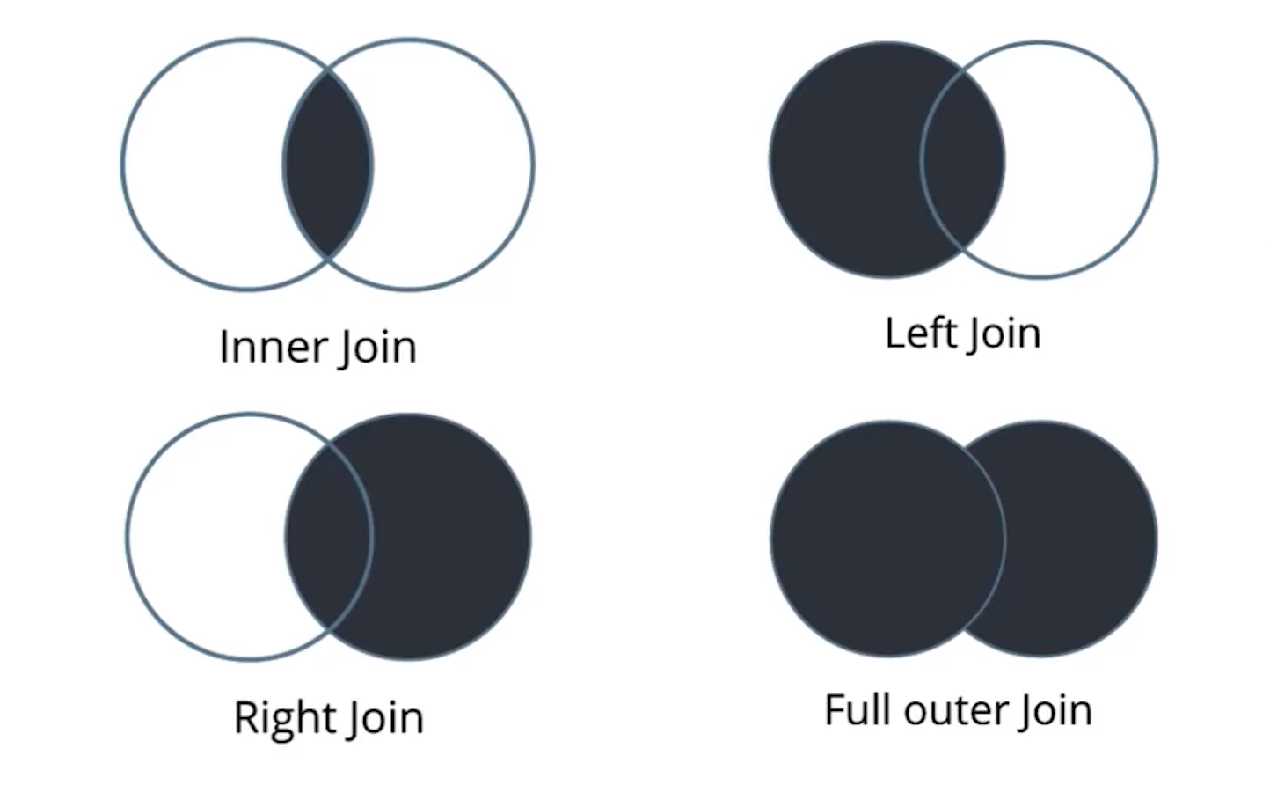
JOINS IN TABLEAU
In Tableau, joins are used to combine data from multiple tables (or data sources) based on common fields (columns) between them.
Types of Joins in Tableau:

Slide 33
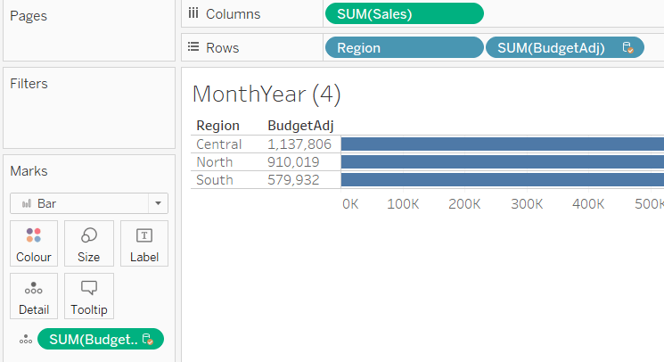
Data blending
Data blending in Tableau is the process of combining data from multiple data sources that are not directly linked, often because they don't share a common database or table.
How Data Blending Works in Tableau:
Set the Primary Data Source
Add the Secondary Data Source
Check the Common Fields (Blend Fields)
View the Results
Data → New Data Source → Choose the secondary data

